Slide 1


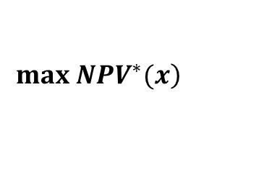


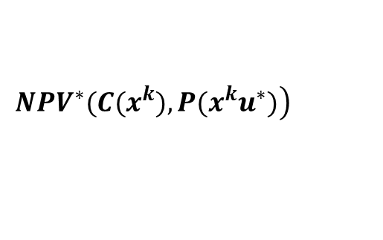


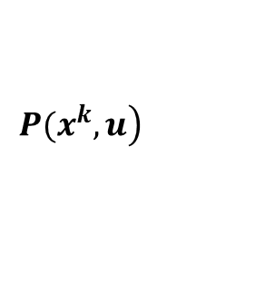

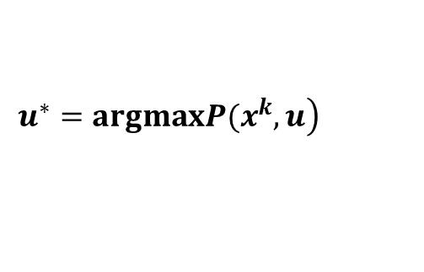


Discrete Variables
Design Optimization (BIP)
$x_{i}$ - FAU Models
$$\left.max NPV^{∗}(x\right)$$
$y_{i}$ - Damper Selection
Weather and Occupancy Data
Cost Data
Calculate OF
$o_{t}$ - Room Occupancy
$c_{i}$ - FAU Model Costs
$$\left.NPV^{∗}(C(x^{k}),P(x^{k}u^{∗})\right)$$
$w_{t}$ - outdoor PM2.5
$c_{d}$ - Damper Unit Cost
Operations Optimization (NLP)
Continuous Variables
$$\left.P(x^{k},u\right)$$
$f_{t}$ - Fan Speed
$$Feasibility$$
$d_{it}$ - Damper Pos
$$\left.u^{∗}=argmaxP(x^{k},u\right)$$

Slide 2
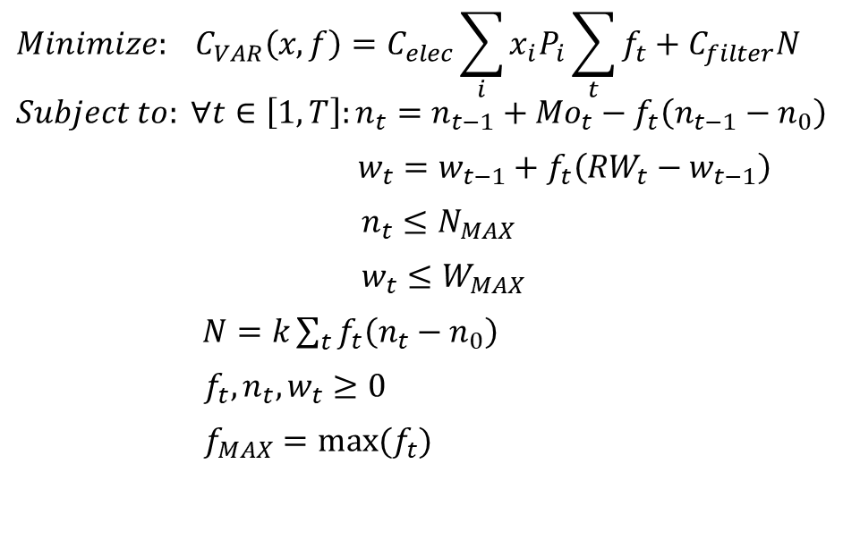
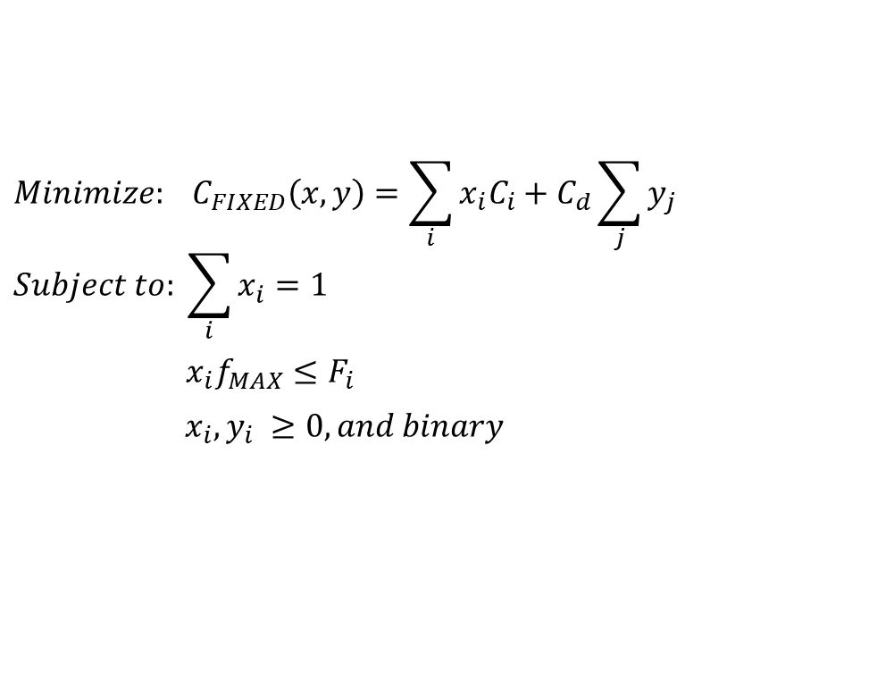
Optimization Problems
Design Optimization (BIP)
Operations Optimization (NLP)
$$Minimize: C_{FIXED}\left(x,y\right)=\sum_{i}{x_{i}C_{i}}+C_{d}\sum_{j}{y_{j}}$$
$$Subject to: \sum_{i}{x_{i}}=1$$
${x_{i}f}_{MAX}≤F_{i}$
$x_{i},y_{i} ≥0, and binary$
$$Minimize: C_{VAR}\left(x,f\right)=C_{elec}\sum_{i}{x_{i}P_{i}}\sum_{t}{f_{t}}+C_{filter}N$$
$$Subject to: ∀t∈\left[1,T\right]:n_{t}=n_{t−1}+{Mo}_{t}−f_{t}\left(n_{t−1}−n_{0}\right)$$
$w_{t}=w_{t−1}+f_{t}\left(RW_{t}−w_{t−1}\right)$
$n_{t}≤N_{MAX}$
$w_{t}≤W_{MAX}$
$N=k\sum_{t}{f_{t}\left(n_{t}−n_{0}\right)}$
$f_{t},n_{t}, w_{t}≥0$
$f_{MAX}=max⁡(f_{t})$

